Slide 1
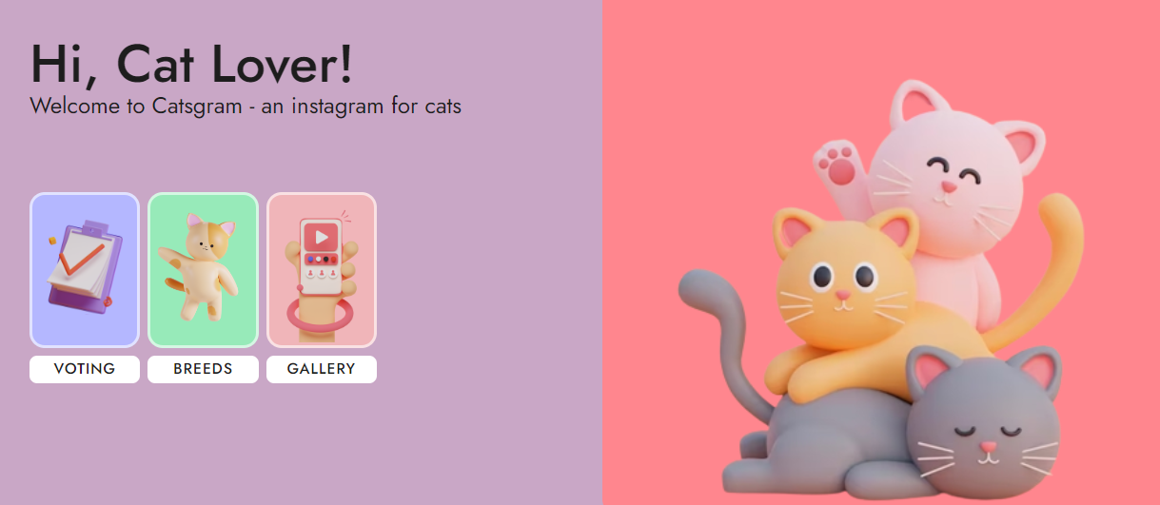
Kinga Hernet – Boolean UK – Final project 2023

Slide 2
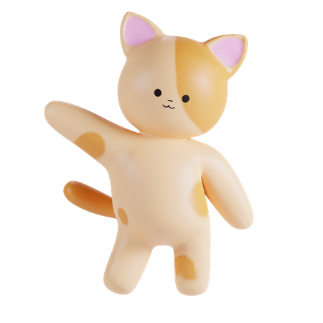
Catsgram🐾 – an instagram for cats
Tech Stack
HTML, CSS, and JavaScript
Node.js & npm
Angular CLI 14.0.5
Bootstrap for responsive design
API from https://developers.thecatapi.com/
Icons and pics are from Iconscout
Developed as the Individual Project during the last week of the BooleanUK bootcamp.

Slide 3
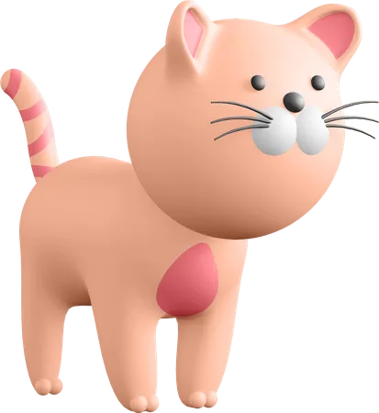
A few user stories
I want a button to reload the available breeds data,
So that I can see updated information without refreshing the entire page.
I want to categorize images or content by specific cat breeds,
I want to be able to filter, sort, and view images based on breeds within the gallery.
I want to like images or content,
So that I can show appreciation for what I enjoy.
I want to add images or content to my favourites,
So that I can easily revisit them later.
I want to dislike images or content,
So that I can express my disinterest or displeasure.

Slide 4
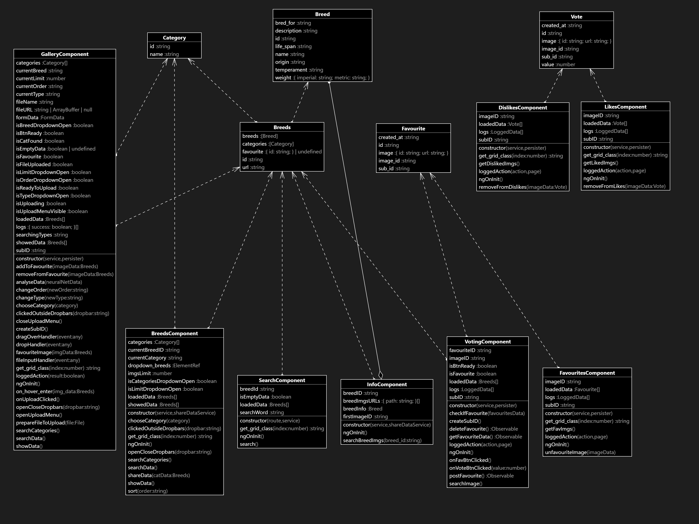
Domain Model
of the main components

Slide 5
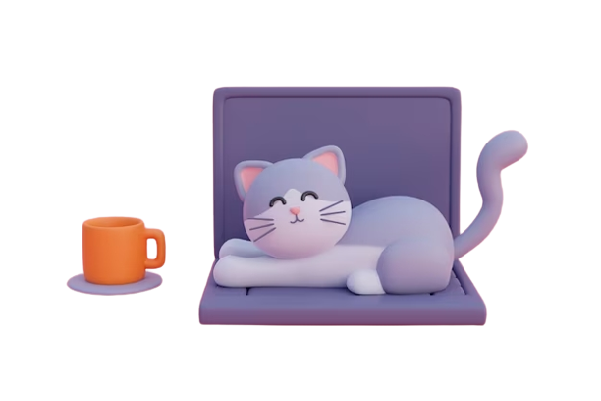
Thanks

